Slide 1
Segregation of Duty Control Monitoring Dashboard
Disclaimer: All data shown in the following dashboard are mock data and was randomly generated for demonstration purposes. None of the companies/applications/names/dates are real.
Here is the website used to generate the redacted data: https://www.mockaroo.com/

Slide 2
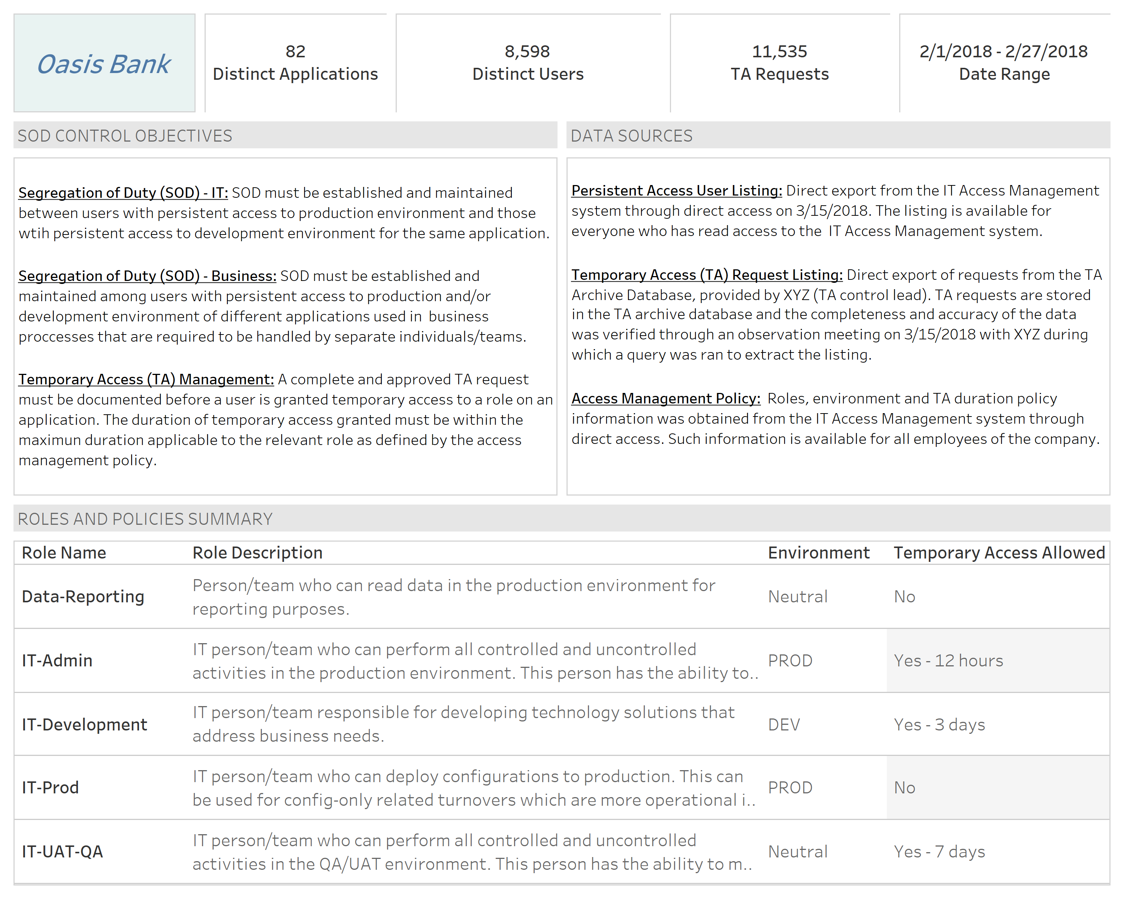
Disclaimer: All data shown in the dashboard was randomly generated for demonstration purposes. None of the companies/applications/names/dates are real. Here is the website used to generate the redacted data: https://www.mockaroo.com/

Slide 3
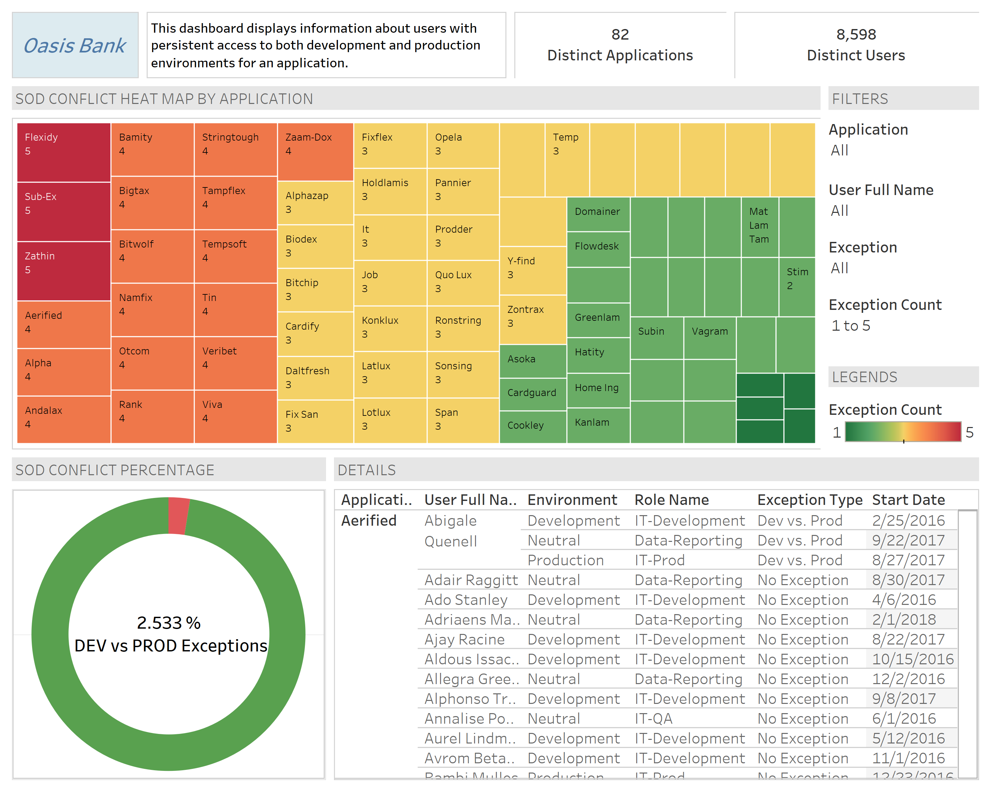
Disclaimer: All data shown in the dashboard was randomly generated for demonstration purposes. None of the companies/applications/names/dates are real. Here is the website used to generate the redacted data: https://www.mockaroo.com/

Slide 4
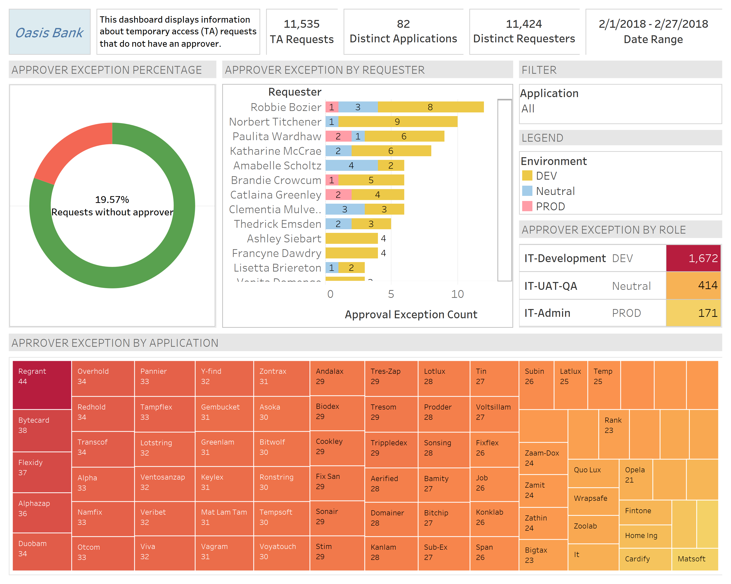
Disclaimer: All data shown in the dashboard was randomly generated for demonstration purposes. None of the companies/applications/names/dates are real. Here is the website used to generate the redacted data: https://www.mockaroo.com/

Slide 5
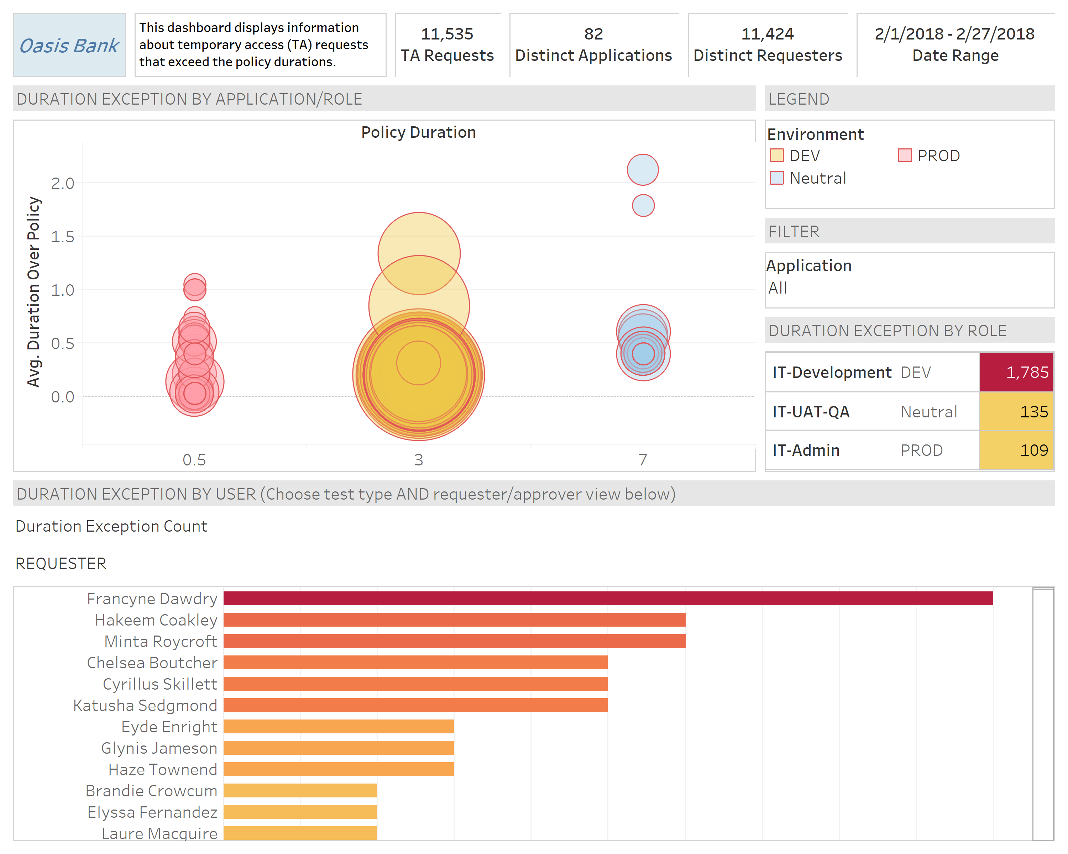
Disclaimer: All data shown in the dashboard was randomly generated for demonstration purposes. None of the companies/applications/names/dates are real. Here is the website used to generate the redacted data: https://www.mockaroo.com/

Slide 6
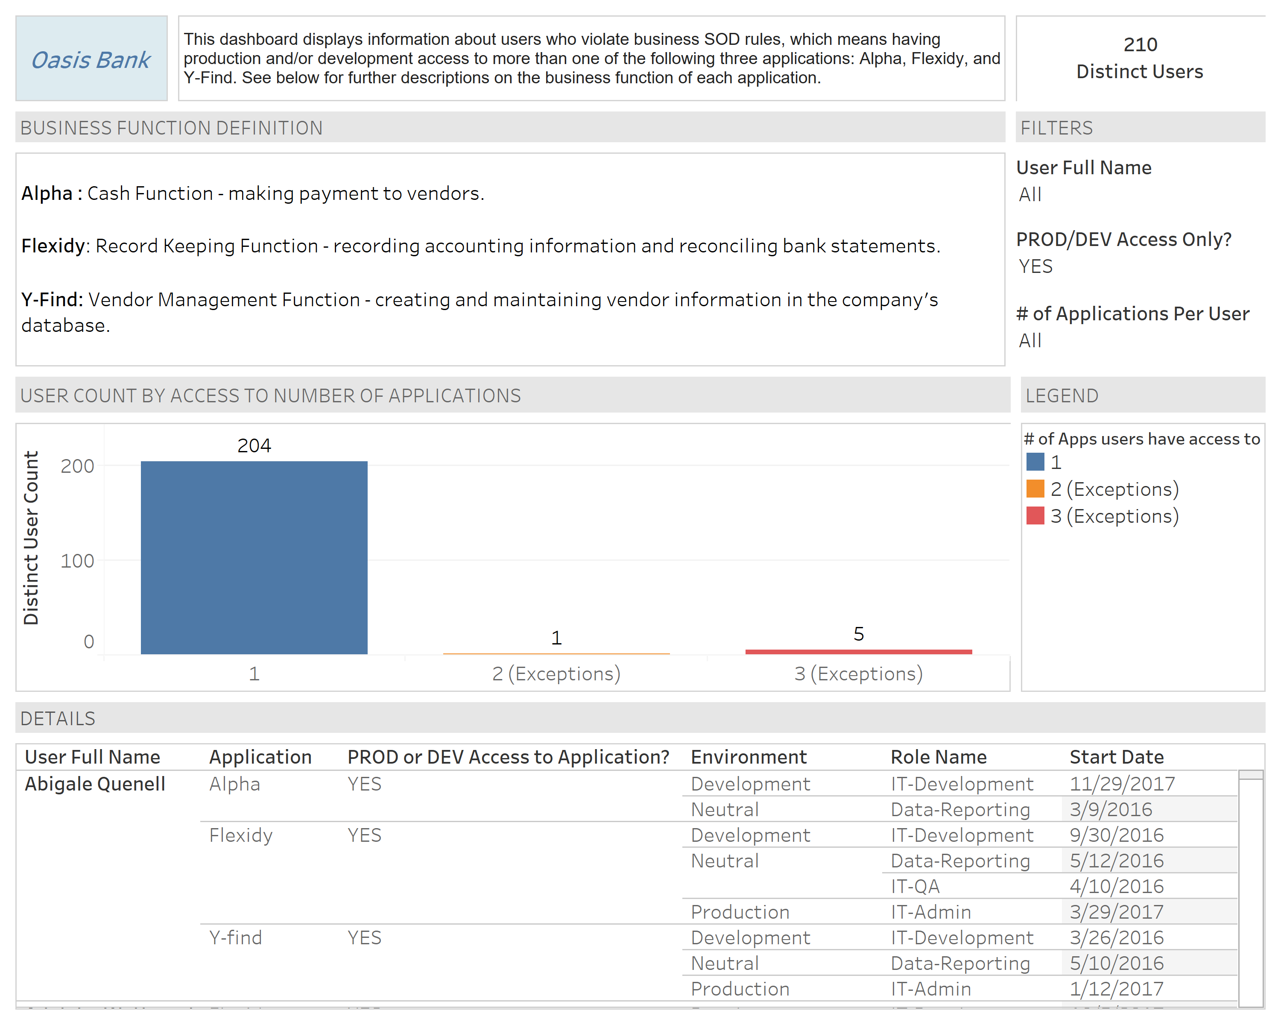
Disclaimer: All data shown in the dashboard was randomly generated for demonstration purposes. None of the companies/applications/names/dates are real. Here is the website used to generate the redacted data: https://www.mockaroo.com/

